Slide 1
Types of quantities
There are 2 categories of Measurable quantities to which all other things belong. They may be either, fundamental quantities which may not be broken down to anything simpler such as length or time, or it maybe a derived quantity; one which is composed of 2 or more fundamental(simpler) quantities, such as miles-per-hour which is composed of 2 fundamental quantities: length(miles) and time(1 hour).

Slide 2
The 5 Classical Fundamental Quantities:

Slide 3
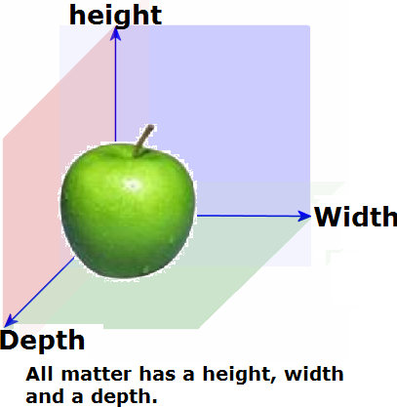
1. Length:
1. Length: Length refers to Measurable dimensions such as height, width or Length. Symbol is l

Slide 4
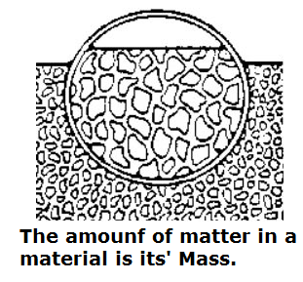
2. Mass:
2. Mass: The amount of a substance that an object contains, anything which exists has mass(please note this is different to it’s weight which is the force produced under the pull of gravity, something on the moon has 1/3 the weight of something on earth but it’s mass remains the same.) Symbol is m

Slide 5

3. Time:
3. Time: measure of duration or sequence of events.
Symbol is t

Slide 6
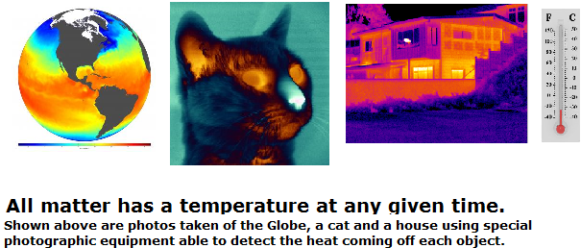
4.Temperature:
4. Temperature: This is a measure of the kinetic energy of the particles of a substance, e.g the particles of a very hot object will be moving very rapidly and will have a high temperature, those of a cold object will move slowly and have a low temperature. Symbol is T

Slide 7
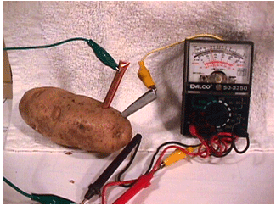
5. Electric current:
5. Electric current: Quantity of electrical charge an object contains, all matter has a certain amount of electrical charge. Symbol is Q

Slide 8
2 More fundamental quantities
6. Luminous intensity: measure of the intensity of light emitted.
7. Amount of substance: Refers to the specific number of atoms an object contains.

Slide 9
Base quantities and their units:
Base Quantities |  | Units
Length | l | Metre | M
Mass | m | Kilogram | kg
Time | t | Second | S
Temperature | T
Celsius | ⁰c | Celsius | ⁰c
Kelvin |  | Kelvin | K
Electric Current | I | Ampere | A

Slide 12
Derived Quantities:
Derived quantities are made of 2 or more base quantities combined by multiplication or division. Such as speed is given as miles-per-hour.

Slide 13
Derived quantities:
Name | Symbol | Unit | Symbol of unit | Composed of units?
Force | F | Newton | N | 1.Kilogram 2. Metres per second per second
Velocity | V | Metres per second | M/s | 1.Meters 2. Second
Pressure | P | Pascal | Pa | Force Area
Energy, work | E | Joule | J | Force Distance second
Power | P | Watt | W | Joules second
Frequency | F | Hertz | Hz

Slide 14
Unit:
Definition: A unit of measurement is a definite amount of a physical quantity, to which other objects or quantities are compared to define how much of something there is. E.g During mid-evil times one foot was defined as the distance, front to back, defined and adopted by convention and/or by law, that is used as a standard for measurement of the same physical quantity.

Slide 15
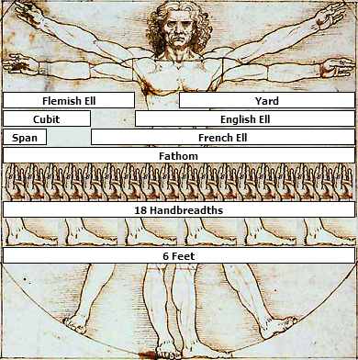

Slide 16
The metre examined:
The meter is defined as ¹⁄_{10,000,000} of the distance from the Earth's equator to the North Pole measured on the circumference through Paris.

Slide 17
Quantity | Example of Imperial Unit | Example of S.I Unit
Length | Foot | Metre
Area | Acre | Sq. kilometre
Mass | Grain/ounce | Gram and kilogram

